Slide 1
July Monarchy

Slide 2
Timeline of French History
First Republic (1792-1804)
First Empire (1804-1814)
Restoration (1814-1830)
July Monarchy (1830-1848)
Second Republic (1848-1852)
Second Empire (1852-1870)
Third Republic (1870-1940)

Slide 3
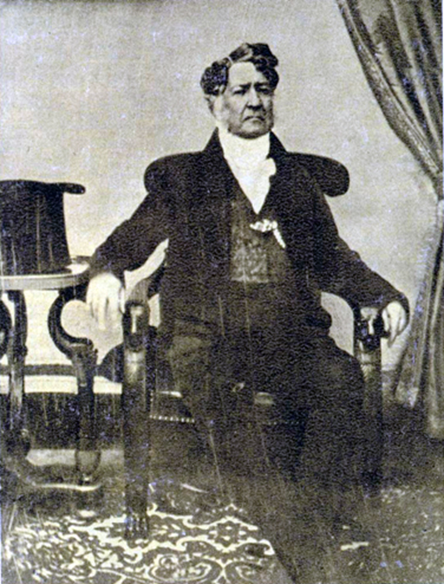
Louis Philippe (r. 1830-1848)
Duc d ’Orleans and cousin of Louis XVI, Louis XVIII, and Charles X
Became king after Charles X abdicated during the July Revolution
His reign known as July Monarchy
“bourgeois king”

Slide 4
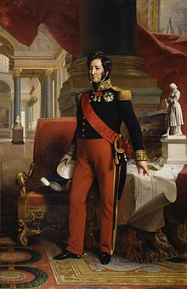
Louis Philippe
seen as not caring about middle or lower class
ruled with elite circle, not interested in spreading right to vote
income gap increased under his rule, conditions of working class deteriorated
over time popularity declined and growing opposition
political cartoonist Honore Dumier depicted unfavorable caricatures of the king
regime fought back against opposition
implemented law against public demonstrations
restrictions on press and arresting political opposition after assassination attempt on king in 1835
had Napoleon’s body returned to France

Slide 5
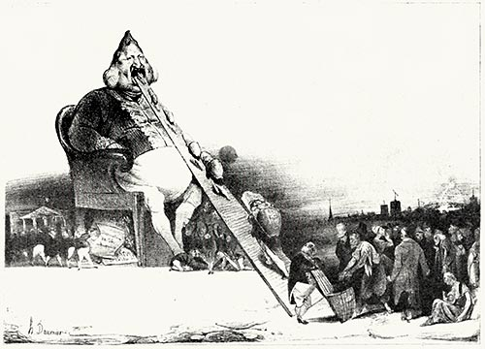

Slide 6
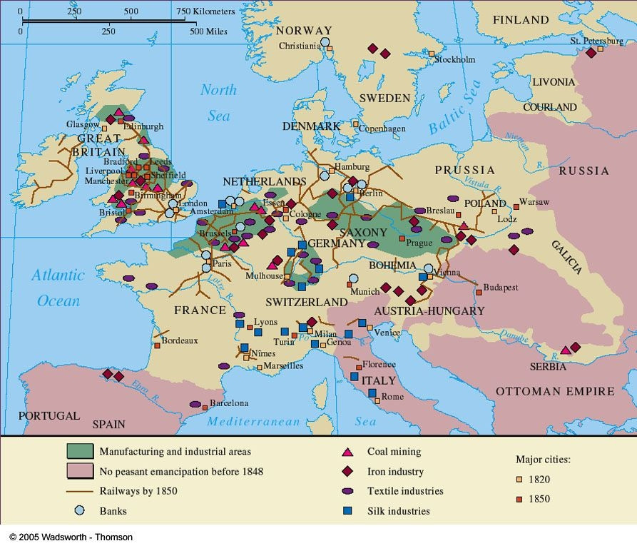
Industrial Revolution in France
began in France in 1830s and 1840s
interrupted by 1848 revolution
slower pace than Britain, especially initially
large factories were rare in France
investors more conservative
profound social changes

Slide 7
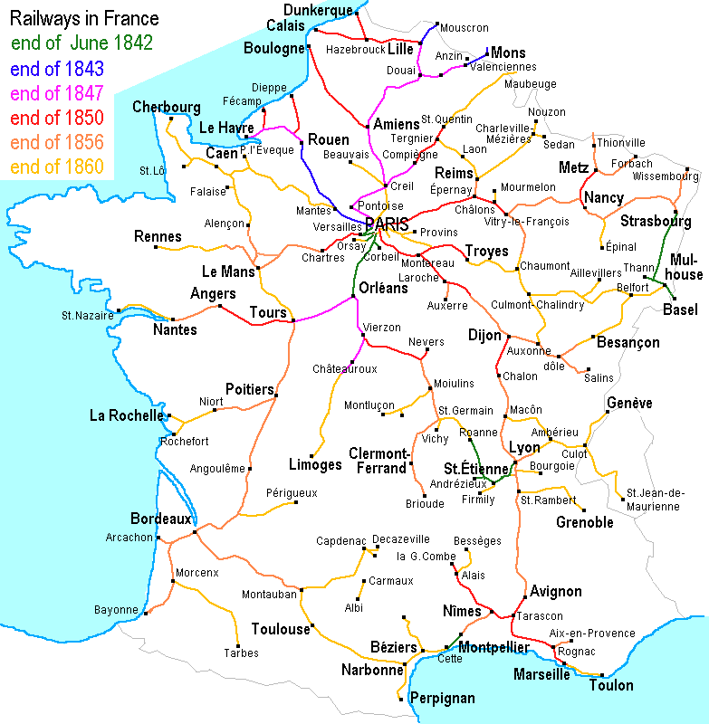
Railroads
First lines in 1830s to connect mines
government funded by 1840s
railroad system connecting Paris to major cities
1860s-rail network connected major cities and towns
Opened up business, especially in small areas, connected them to Paris and internationally
Movement of people

Slide 8
Industrial Society
urbanization-growth of industry led to new jobs, not just in factories but in service industry
growing isolation of bourgeoisie during this period
growing appeal of socialism among working class
strongest in industrial areas
not a unified movement as in Germany
Anarchists-turned to violence, setting off explosives, assassinations

Slide 9
Society and Culture
increasingly literate population
spread of newspapers, books, art exhibitions, museums, public talks and events
romanticism-dominated French literature in early 19th century
reaction to Enlightenment and Industrial Revolution
emphasis on emotion
Alexandre Dumas- The Three Musketeers (1844), The Count of Monte Cristo (1846)
Victor Hugo-Les Misérables (1863), The Hunchback of Notre Dame (1831)
building national memory
transforming Versailles into museum of French history
1840 Napoleon’s body brought to Paris
politics remained limited to narrow group of elites by the end of the July Monarchy

Slide 10
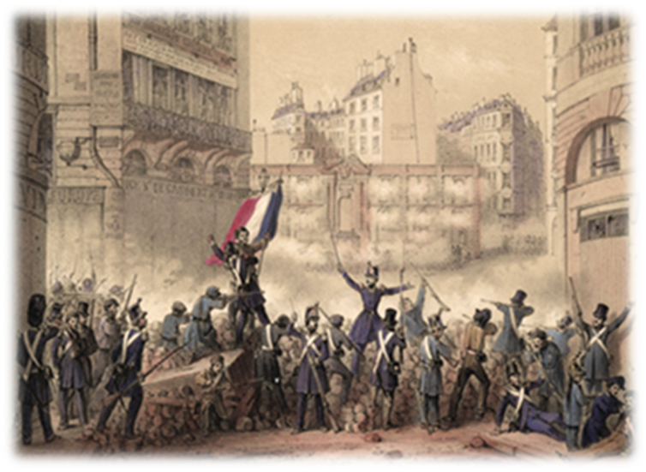
February Revolution/ French Revolution of 1848
economic anxiety in years prior
growing social and political discontent
opposition from upper and middle class who wanted more of a say in government
political organizations illegal so opposition hosted banquets all over France
outlawed in February 1848
People went to the streets demanding reform
Louis Philippe abdicated in favor of his grandson, but the people wanted a Republic
provisional government declared a Second Republic led by Alphonse Lamartine

Slide 11
1848
government enacted universal male suffrage
moderate government elected- opposed by radicals especially in Paris
continued uprisings against the government later in the summer- June Days Uprising
workers and artisans took to the streets of Paris
harsh reaction by government, justification for repressive measures
new constitution passed and elections for president
December 1848 vote-shock results-Louis Napoleon Bonaparte won
three years later he suspended assembly and established Second French Empire

Slide 12
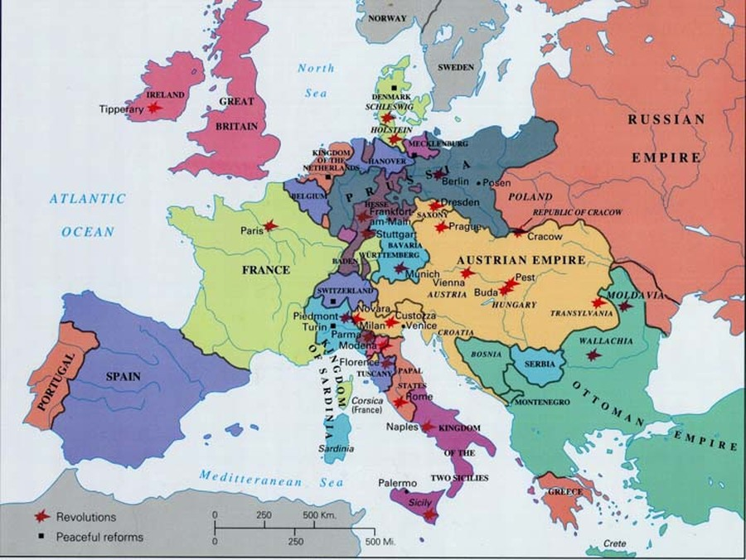
1848 in Europe
uprisings spread from France throughout Europe: Germany, Italy, Austria-Hungary
university students, workers, middle class and artisans demanding civil liberties, political rights, and economic reform
liberals wanted parliaments and constitutions, nationalists wanted unity or independence for their nations, industrial workers wanted more rights
eventually put down but indicated a growing sentiment throughout Europe

Slide 13
Review:
Louis Philippe came to power in 1830-his reign known as the July Monarchy
In 1848, February Revolution overthrew Louis Philippe
Liberal, nationalistic revolutions broke out all across Europe that year
Second Republic declared in France and Louis Napoleon elected
President from 1848 to 1852- Second Republic
Emperor from 1852 to 1870-Second Empire

